Slide 1
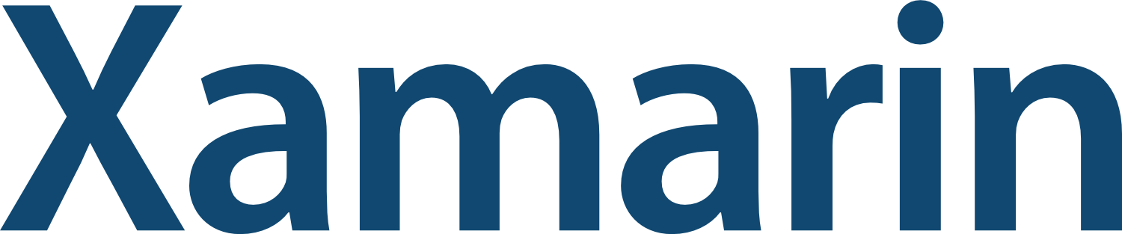
Enterprise Mobile Apps. Cross-Platform that works.
X-Platform Starter

Slide 2

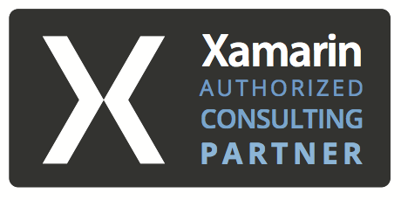
Allan Pead
Twitter: @adpead
Email: apead@adsoftsystems.co.za

Slide 3
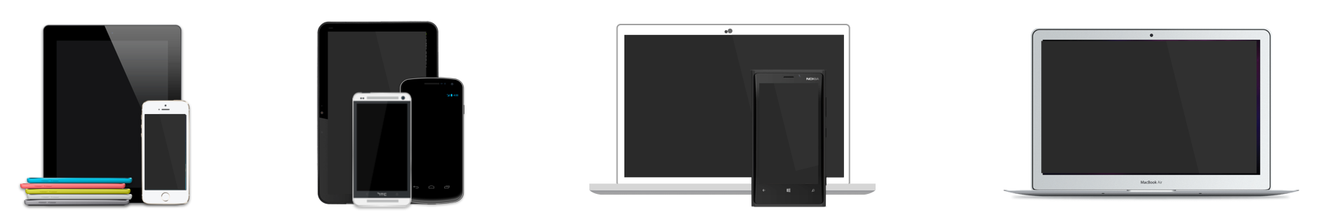

Write Everything in C#
iOS, Android, Windows, Windows Phone, Mac
2.5+ Billion Devices!

Slide 4
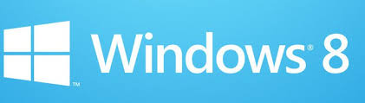
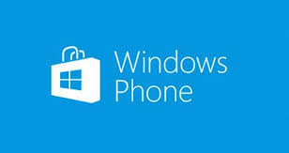






Slide 5



Slide 6
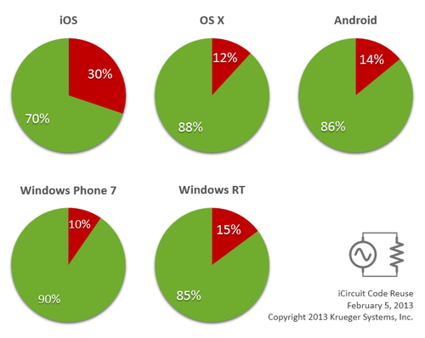

Slide 7


Slide 8
What Framework?????

Slide 9
S ingle Responsibility
O pen Closed Principle
L iskov Substitution Principle
I nterfaces Segregation
D ependency Inversion
http://en.wikipedia.org/wiki/SOLID_(object-oriented_design)

Slide 10
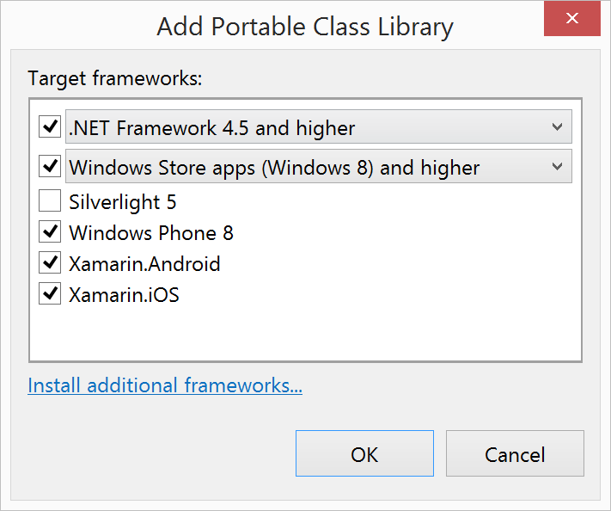
PCL

Slide 11
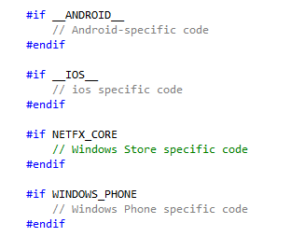
File Linking

Slide 12

IOC

Slide 13
MVVM
ViewModel
View
Model

Slide 14
MVC
Controller
View
Model

Slide 15
MVC vs MVVM
MVC
Controller is generally more powerful than a ViewModel
Entry Point (or user interaction) starts with Controller
The View knows about the Model
The View is Generally passed an instance of the Model
MVVM
ViewModels are generally simpler than a Controller
Links the View to a Model
Entry Point (or user interaction) starts with View
View has no knowledge about the Model
View has an instance of the ViewModel
One ViewModel per View

Slide 16
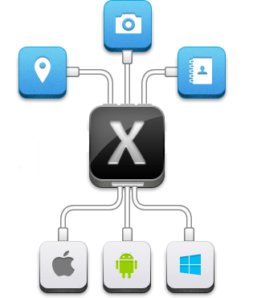
Xamarin.Mobile
https://components.xamarin.com/gettingstarted/xamarin.mobile

Slide 17
Frameworks
http://monocross.net/
https://github.com/MacawNL/MvvmQuickCross
https://github.com/MvvmCross/MvvmCross
http://mvvmlight.codeplex.com/SourceControl/network/forks/onovotny/MvvmLightPortable

Slide 18
